Slide 1
CNNs In Depth
Lamia Zain
lamiahasan4@gmail.com
LinkedIn
June,28, 2024

Slide 2
Connect Sessions | Purpose
Connect Session
A Connect Session IS:
A Connect Session IS NOT:
Focused on learning, encouragement & graduation for a group of students coached by a Udacity Session Lead
Setting weekly study goals
Helping each other with progress (including peer to peer)
Keeping everyone accountable for their responsibilities
A way to meet individuals in tech field & learn about the industry
Mandatory
A social meetup
A study group
A substitute for online learning
Optional
Notes:
Here a snapshot of what a Connect Session is and is not. It is a space/time where you lead the students through their learning journey. They will have the chance to ask you questions and progress through the Classroom and their projects. We will discuss the content of each Connect Session more in depth in the coming slides.

Slide 3
Let’s check your progress
You are encouraged to spend at lest 10 hours/week to graduate.
Presentation date

Slide 4
Attendance is taken automatically
Please change your name to be First Name and Last name on Zoom Like : Lamia Zain

Slide 5
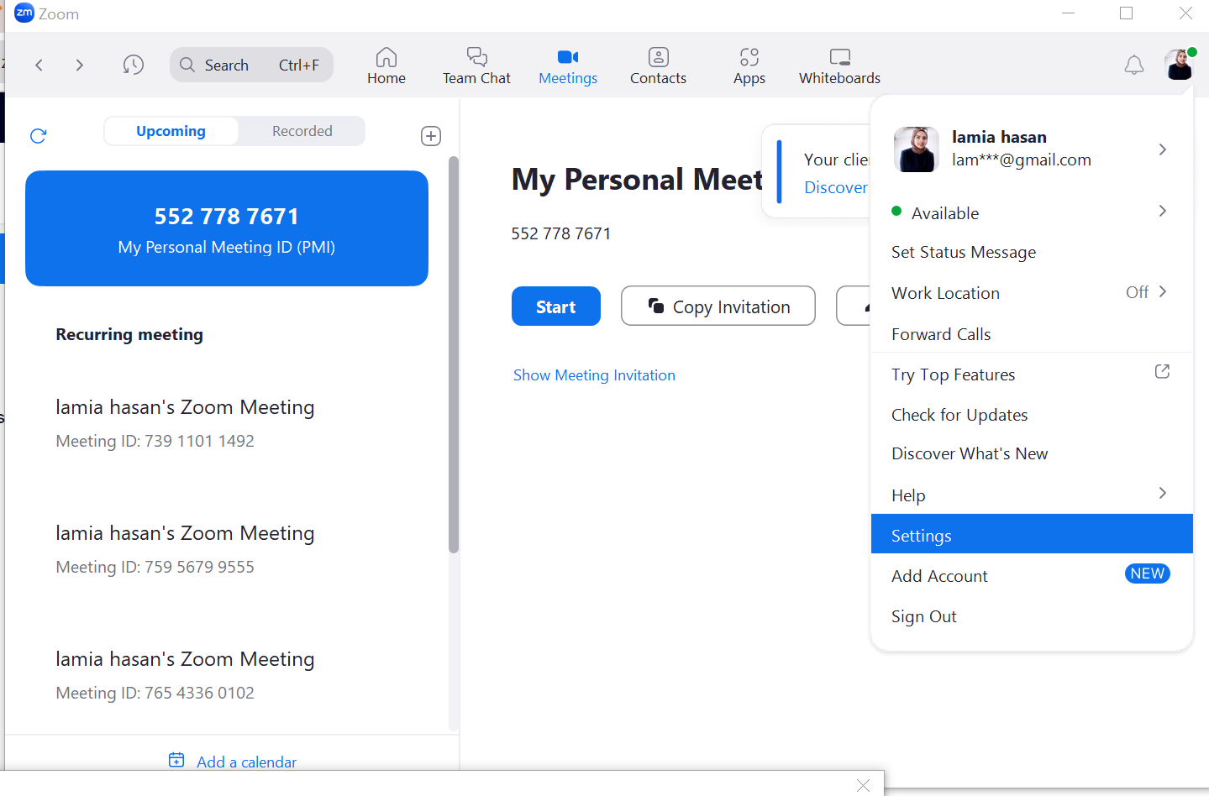
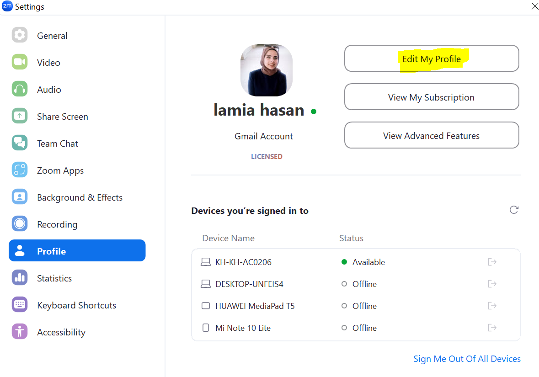
Change your Name on Zoom

Slide 6
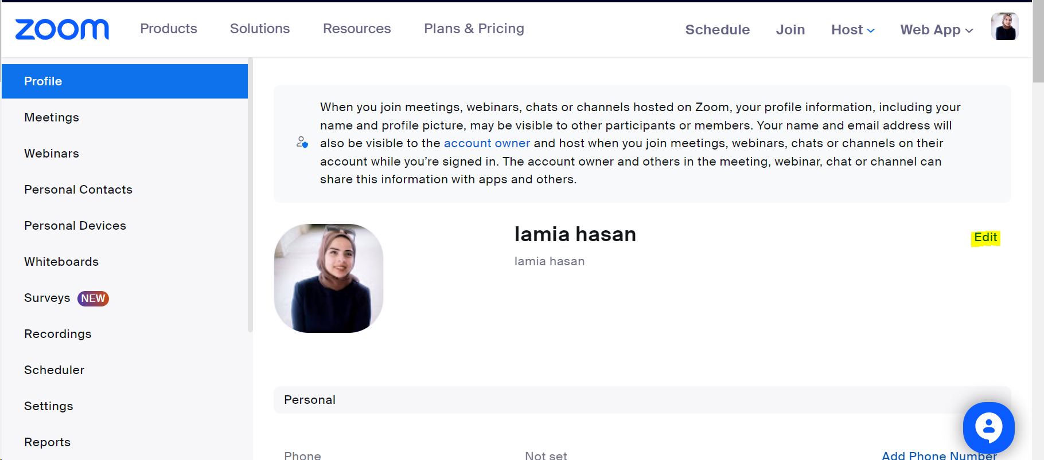
Change your Name on Zoom

Slide 7
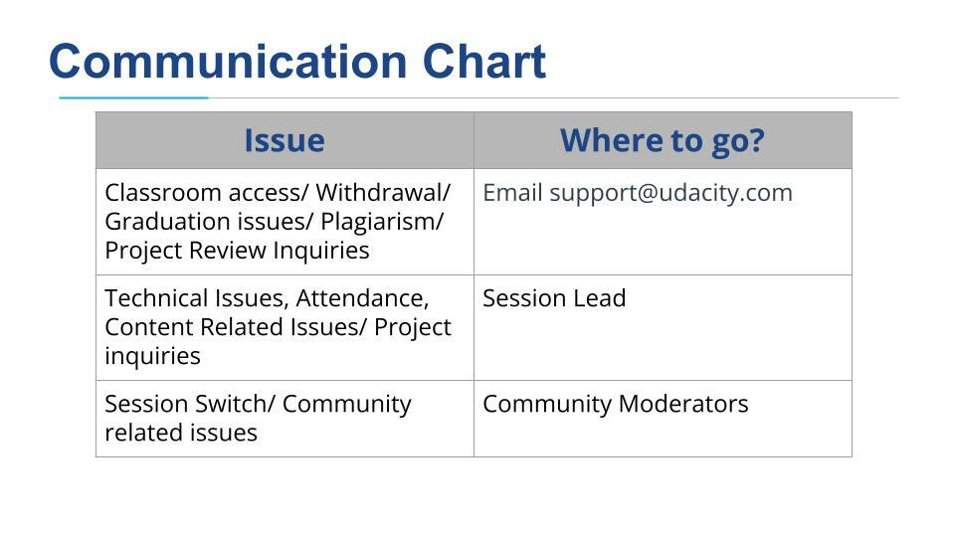
Session Lead role:

Slide 8


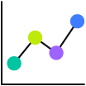


Program Timeline & Learning Journey
2024
April | May | June | July | August
Program Kickoff
April 10, 2024
Revoking Deadline
May 12, 2024
End of Program
August 28, 2024
First Project Submission
May 1, 2024
Second Project Submission
June 5, 2024
Third Project Submission
July 10, 2024
Fourth Project Submission
August 21, 2024
Program Period
April 10 - August 28, 2024
Notes:
For this specific AWS scholarship program, students will be enrolled on April 10 and revoking takes place on May 12. Then the rest of the program runs through August 28. You can also see the project deadlines, there are 4 total projects in this program.

Slide 9
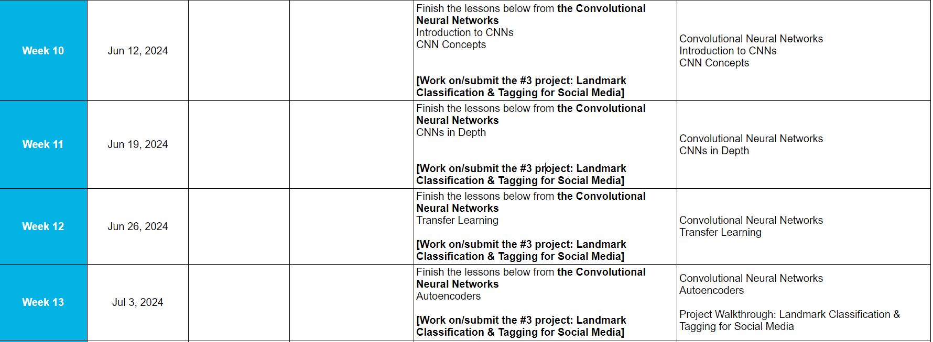
Four-weeks Agenda, Weekly schedule
Notes:
A key element of our Student Code of Conduct is avoiding plagiarism. Project submissions must consist of original work and reviewers scan projects for plagiarism. Anyone found to have plagiarized will risk being revoked. If students feel that they have been wrongfully accused or flagged for plagiarism, they can write in to the Support team to appeal. There is also no action here from your side, just as a reminder to students.

Slide 10

Student Milestone | Revoking
Program Overview
REVOKING
CRITERIA
Revoking is the process by which Udacity removes a student from a Nanodegree program.
AWS reserves the right to revoke you from the program if you do not comply with program requirements.
Students can be revoked if they fail to:
Submit Project 1
Complete the required concepts
The date of Revoking for the scholarship is May 12, 2024
Notes:
Another important milestone in the student journey is what we call revoking. Revoking is the removal of students from the program because they did not make sufficient progress by the deadline set. For this program, revoking will take place on May 12. If a student has not submitted their first project or completed the required concepts by May 12, they will be removed from the scholarship. There is nothing you as an SL will need to do, other than communicate the importance of this with students.

Slide 11
Code of Conduct | Plagiarism
Program Overview
BASIC RULES
Project submissions must consist of original work
Submitted projects will be scanned for plagiarism
Students who are found to have plagiarised will risk their Nanodegree being revoked
Read the honor code and the rubric carefully for all projects
Notes:
A key element of our Student Code of Conduct is avoiding plagiarism. Project submissions must consist of original work and reviewers scan projects for plagiarism. Anyone found to have plagiarized will risk being revoked. If students feel that they have been wrongfully accused or flagged for plagiarism, they can write in to the Support team to appeal. There is also no action here from your side, just as a reminder to students.

Slide 12
Objectives:
Augmentation
Batch Normalization
Train A Custom-CNN with the Tiny ImageNet Dataset From HuggingFace

Slide 13
Recap

Slide 14
CNN Architecture

Slide 15
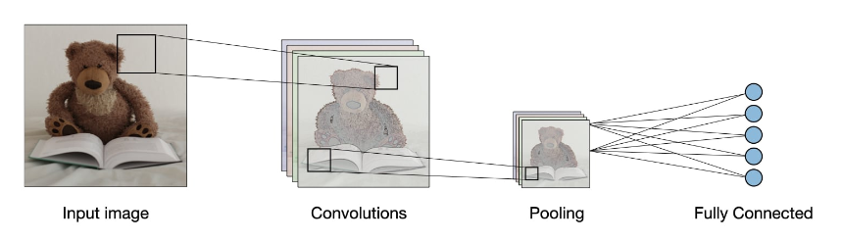
Cs230 – Stanford University

Slide 16
Train a Simple CNN for Fashion MNIST Dataset

Slide 17
Data Augmentation

Slide 18
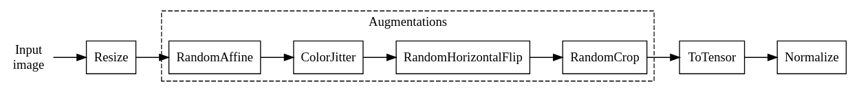
Data Augmentation
Data Augmentation:
Increase the size of the training dataset scenarios that will be fed to the training process
by applying various transformations to the existing data.
Goal -> Generalization & avoid overfitting & robustness of the CNN model by exposing it to different variations of the original data
Typical Transformation pipeline for training images:
Data augmentation doesn't increase the physical size (number of unique images) of your dataset but enriches it by presenting variations of each image to the model during training

Slide 19
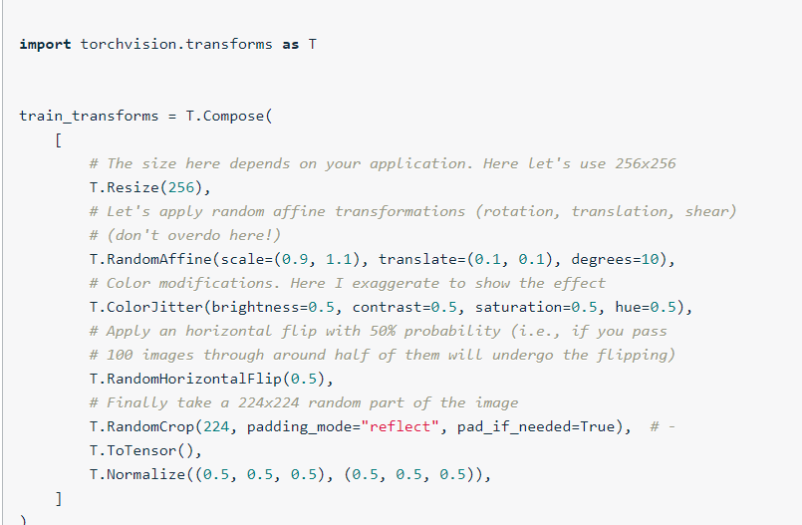
Data Augmentation
Typical Transformation pipeline for training images:

Slide 20
Important: Don’t Use Extensive Augmentation. By that You are ruining your Original DataSet & Features and your model might strugglr to Learn

Slide 21
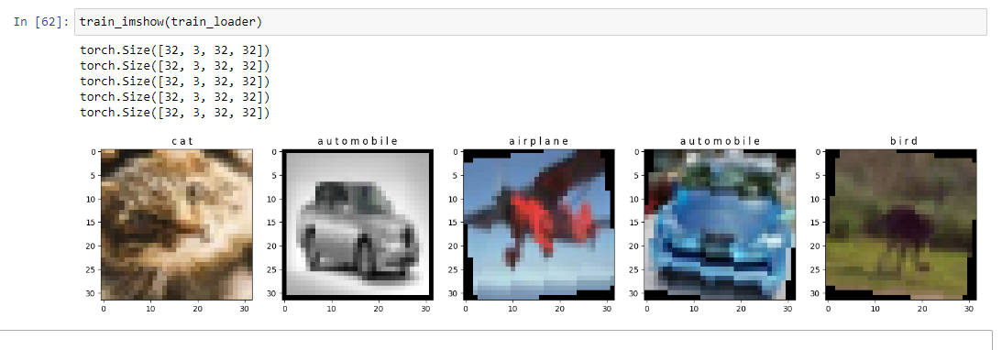
Data Augmentation
RandomAffine:
Scaling → resizing to larger (adding pixels)/ smaller images (removing pixels ).
Estimation of pixel values to be added while maintaining Input size is called Interpolation.
Nearest Neighbor Interpolation: each new pixel takes the value of the nearest original pixel
Bilinear Interpolation: It calculates the weighted average of the nearest pixels based on their distances from the new pixel

Slide 22
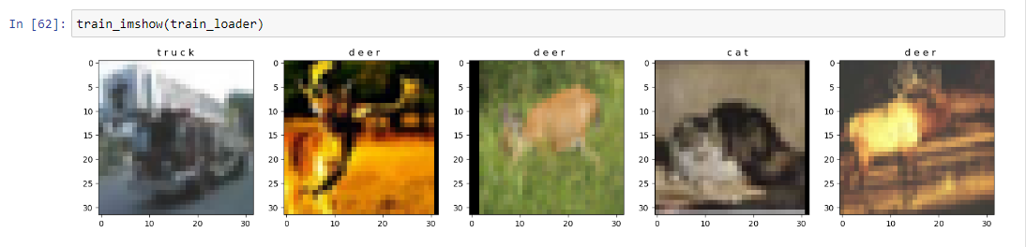
Data Augmentation
RandomAffine:
Translation → tuple of maximum absolute fraction for horizontal and vertical translations

Slide 23
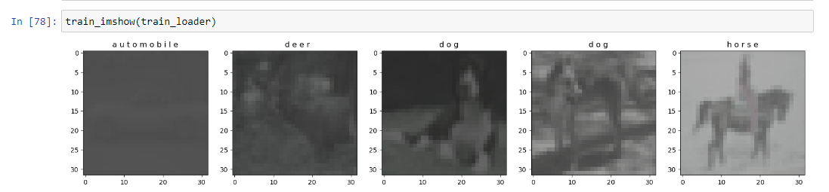
Data Augmentation
ColorJitter:
Randomly change the brightness, contrast, saturation and hue of an image

Slide 24
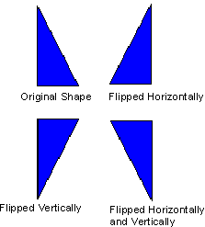
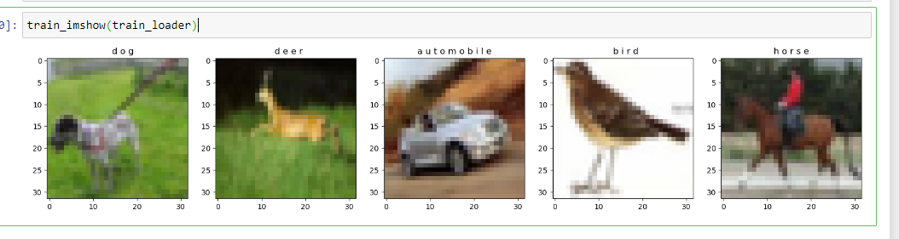
Data Augmentation
Random Horizontal flip:
Horizontally flip the given image randomly with a given probability.

Slide 25
Batch Normalization

Slide 26
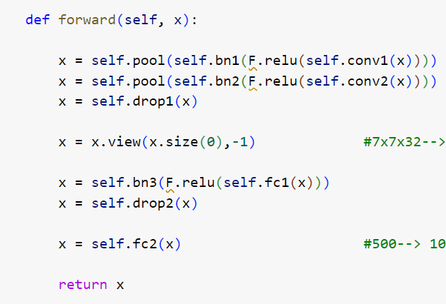
Batch Normalization
It normalizes the activations of each layer / the inputs to each layer so that they have a mean of zero and standard deviation of 1.
Added after the generation of feature maps.
Why used?
1- Internal Covariate Shift Reduction
2- Regularization effect / reduces overfitting and hence, better generalization
3- Faster convergence
4- Reduced Dependency on Initialization

Slide 27
Apply Batch Normalization to Tiny ImageNet

Slide 28
Break (10 minutes)
Satisfaction Survey

Slide 29
Project

Slide 30
If Consumed all Udacity Given GPU: 1- Email support to add extra hours to your account (scholarships-support@udacity.com) 2- You can use SageMaker studio Lab free GPU (4 hours / day) 3- Migrate to AWS account with SageMaker studio classic

Slide 31
If Consumed all Udacity Given GPU: Common approach is to remove all versions of the libraries in the requirements.txt file and let pip decide which versions to install

Slide 32
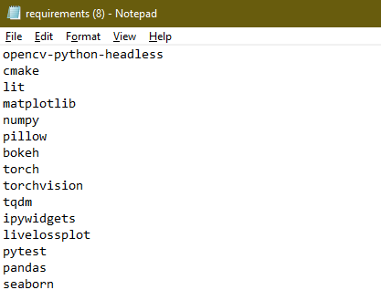
Notes
AWS kernels aren’t supporting python3.7 anymore.
If you are using Udacity’s classroom instance, skip this part.
Remove packages’ versions in requirements.txt.
Let pip install the versions compatible with one another and with Python 3.10

Slide 33
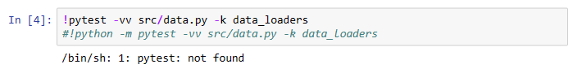
Pytest error in Udacity Workspace

Slide 34
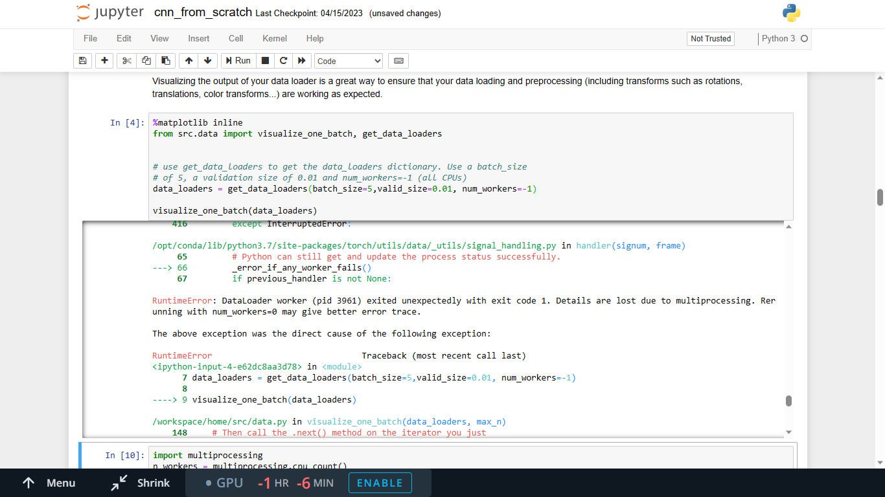
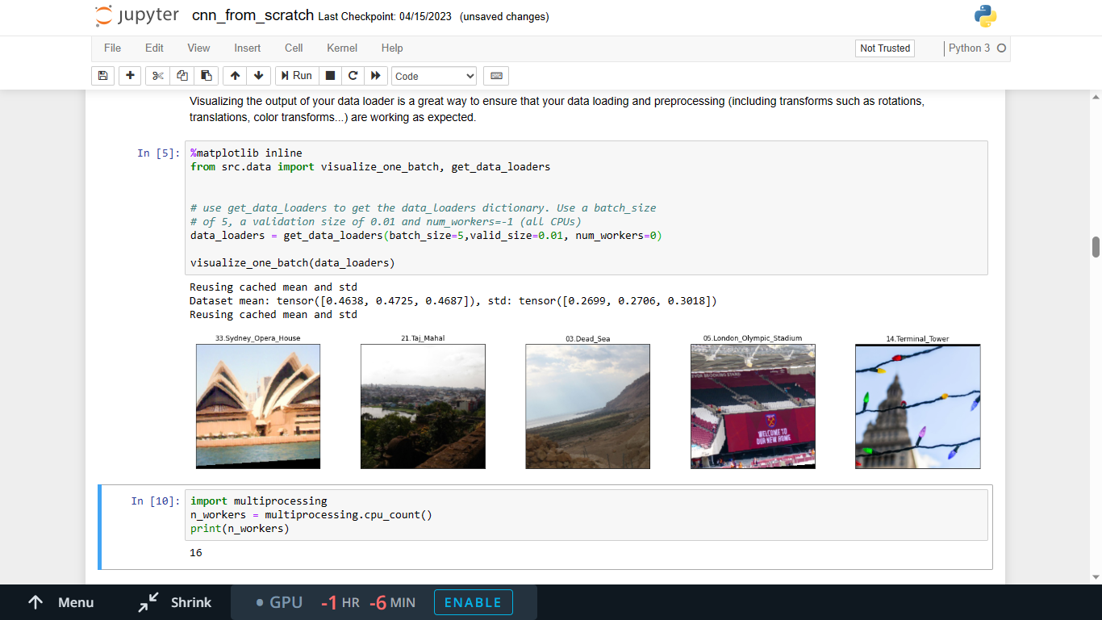
Num_worker error

Slide 35
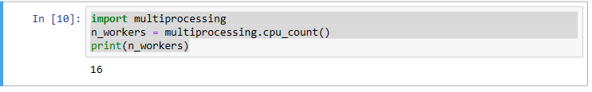
Num_worker error
When setting num_workers=-1, the get_data_loaders function in data.py calculates number of cores for multi processing which seems to have a problem in pytorch old versions
Use multi-threading instead: If num_workers continues to cause problems, consider using multi-threading (num_workers=0 or num_workers=1), which might work better in certain environments.

Slide 36
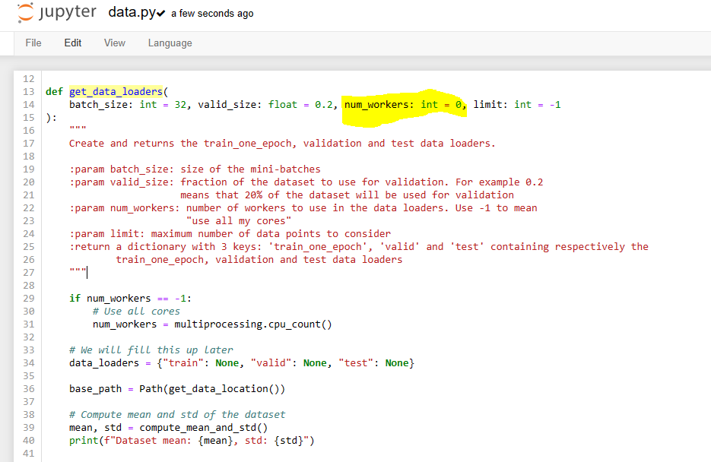
Num_worker error

Slide 37
Any change you do to any .py file, restart your notebook to see an action

Slide 38
Access the checkpoints folder Solved

Slide 39
App.ipynb Problems

Slide 40
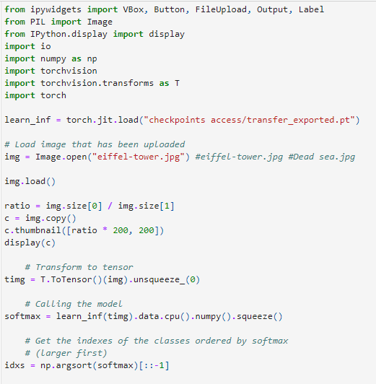
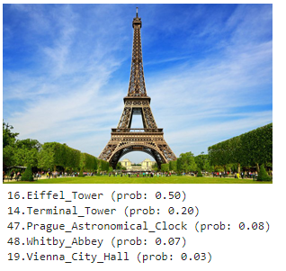
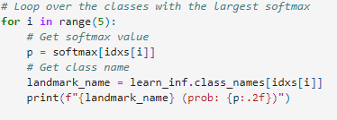
List out of index error
Cell Output
Cell Input

Slide 41
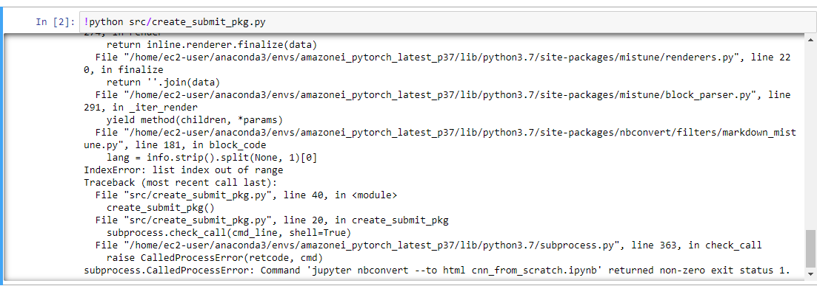
jupyter nbconvert
If you faced this error, One way to work around is to use an online tool that would convert the ipynb file to HTML file.

Slide 42
Any Question?

Slide 43
Thank you

